Slide 1
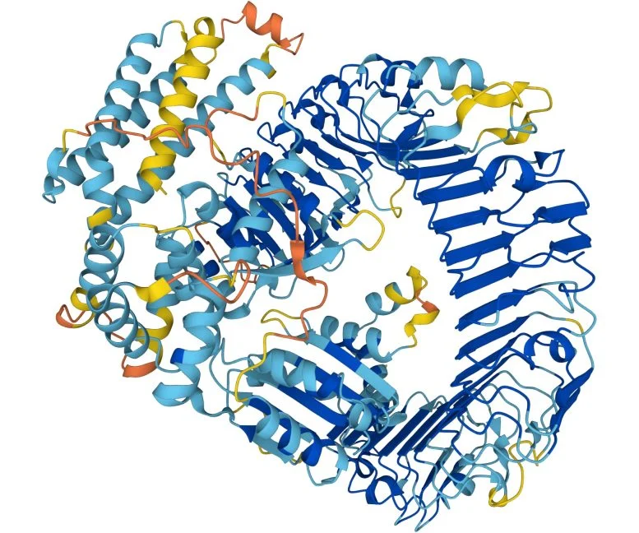
From Sequence to Structure: How AlphaFold Sees Proteins in 3D
Q8W3K0: A. thaliana resistance protein for Hyaloperonospora arabidopsidis. Credit: AlphaFold
Alexander Fast
University of Florida Dept. of Plant Pathology

Slide 2
Overview
Crash Course in Protein Biology
Pre-AlphaFold Protein Structure Determination Methods
How AlphaFold3 Works
Limitations and Applications of AlphaFold3
Future Directions of AlphaFold
Hands-On with AlphaFold3

Slide 3
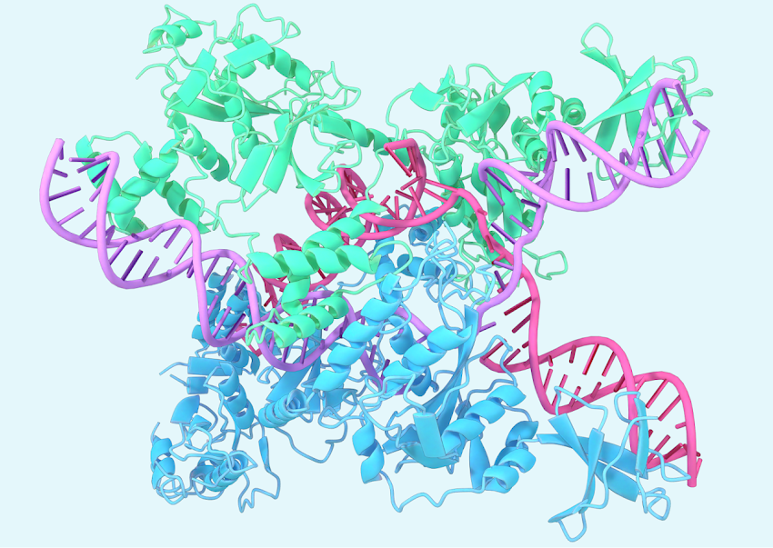
AlphaFold is an artificial intelligence algorithm that can determine a protein's 3-D structure from its amino acid sequence

Slide 4
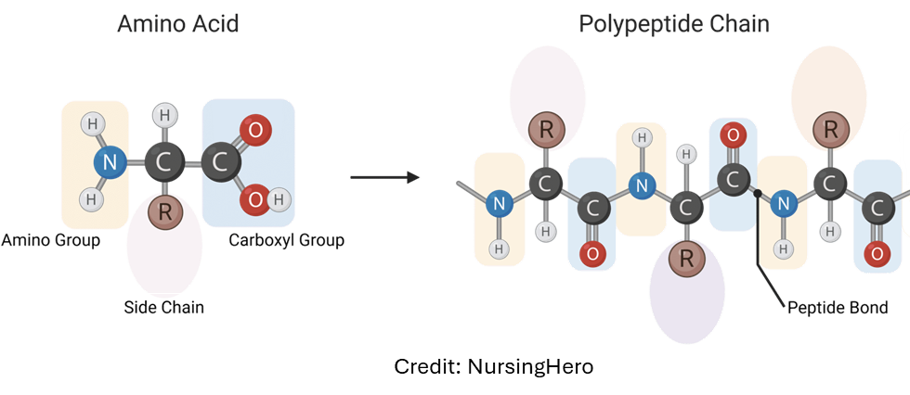
Levinthal’s Paradox: Despite the incredible complexity of protein structures, they fold correctly in milliseconds
Phi (ϕ) Psi (ψ)
150 amino acids
2 backbone angles per amino acid (Phi & Psi)
150 side chains
Each side chain has ~3 stable conformations (Chi)
3^{((2 × 150) + 150))} = 10²¹⁵ possible protein shapes
Age of the Universe: 10¹⁸ seconds
Chi (χ)
Credit: MicrobeNotes.com
Protein folding and shape are primarily driven by interactions between amino acid side chains.
Notes:
If a computer modeled 1 billion proteins per second it would still take 10²⁹¹ seconds – significantly longer than the age of the universe. Yet nature allows the correct folding of a protein in milliseconds. This means protein folding is not random – therefore there should be a way to determine how proteins fold.
Protein folding and shape are primarily driven by interactions between amino acid side chains — including hydrophobic forces, electrical charges, hydrogen bonding and more.

Slide 5
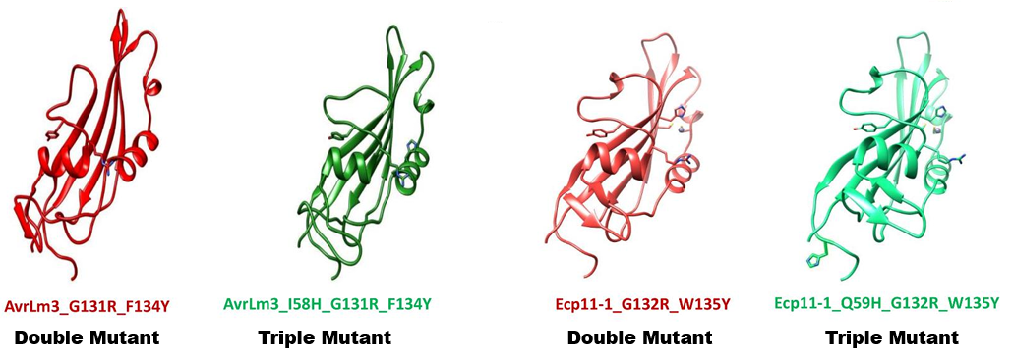
The shape of the protein is what drives its function(s)
A.) AvrLm3 from Leptosphaeria maculans
B.) Ecp11-1 from Fulvia fulva
Credit: Taldi et al. (2025)
Notes:
AvrLm3 effector from Leptosphaeria maculans is recognized by the corresponding R protein in rapeseed. Ecp11-1 is a homologue of AvrLm3 in Fulvia fulva, which is also recognized by the corresponding R protein in rapeseed. Taldi et al introduced point mutations to 2 and 3 amino acids in both effectors, and found that only two mutations and three mutations are necessary to escape recognition by rapeseed for AvrLm3 and Ecp11-1, respectively. This showcases just how specific the structure of proteins are in the functions they carryout.

Slide 6
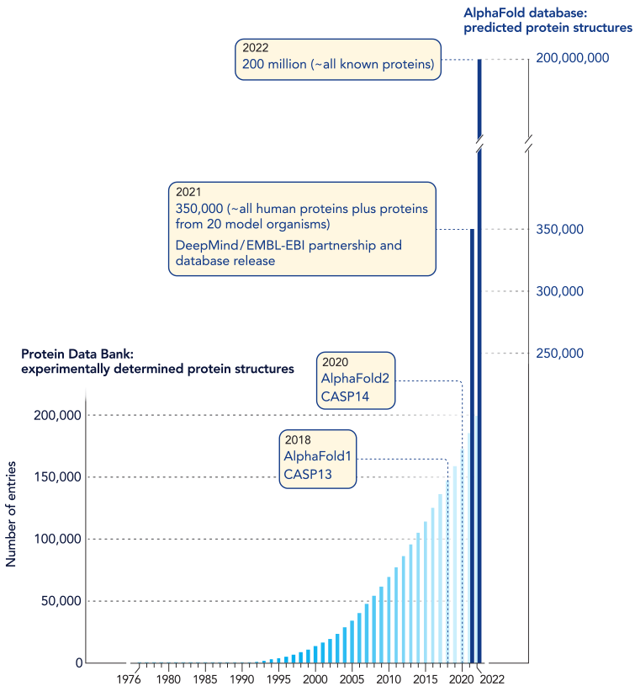
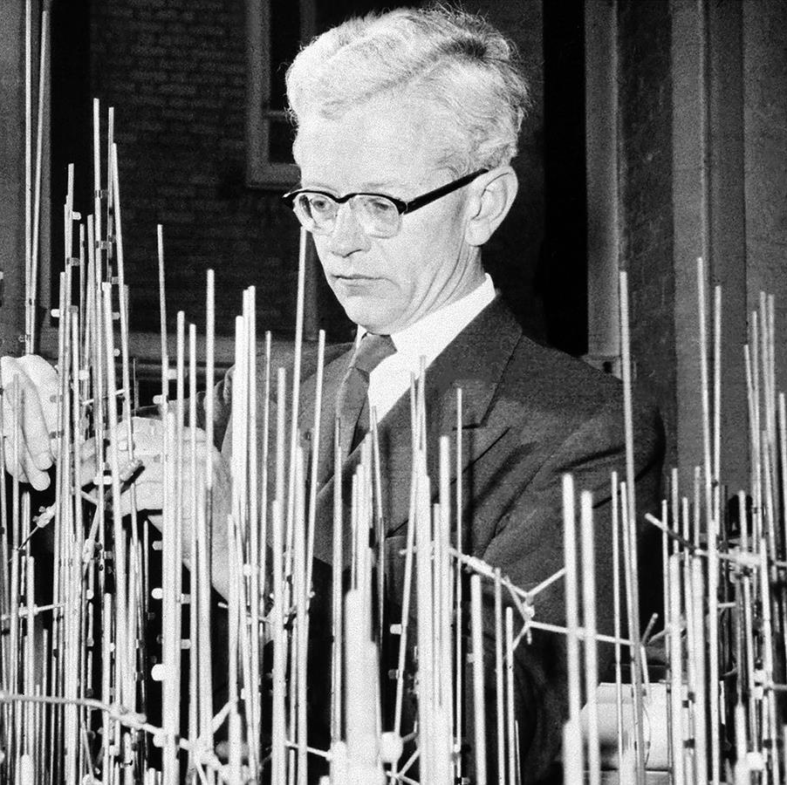
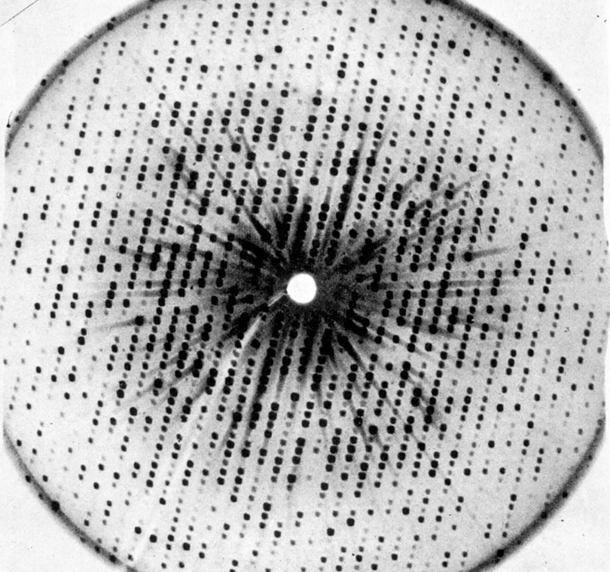

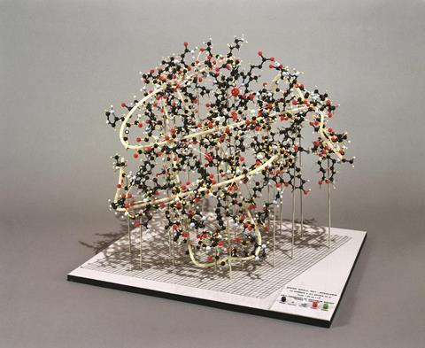
Before AlphaFold, determining the structure of a protein was tedious, labor-intensive and expensive
John Kendrew
Credit: Royal Society of Chemistry
Credit: de Chadarevian (2018)
Credit: Royal Society of Chemistry
Credit: Lasker Foundation
Notes:
John Kendrew won the 1962 Nobel Prize in Chemsitry for uncovering the first protein structure – it took 12 year. They used x-ray crystallography – in which they crystalized the protein, blasted it with an x-ray to get a diffusion pattern and they tried to figure out what shape would cause that pattern.
Before AlphaFold2, the total number of protein structures between 1950 and 2020 was ~170,000. Then AlphaFold2 was able to determine ~350,000 proteins in a single year – and then 200 million!

Slide 7
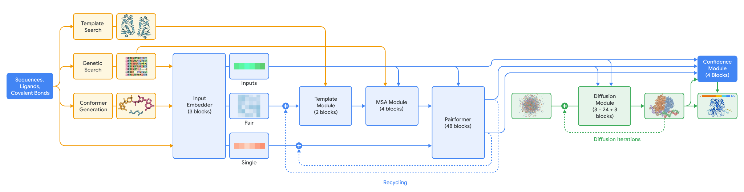
AlphaFold3 uses generative modeling to predict beyond just single proteins
Search for Similar Examples
Credit: Abramson et al. (2024)

Slide 8
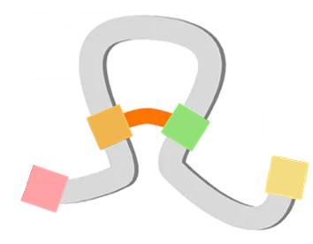
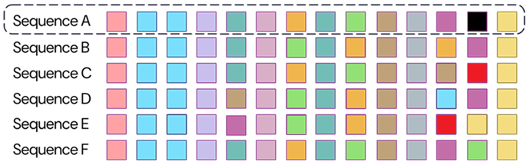
A multiple sequence alignment allows for evolutionary insights into important parts of the protein’s structure
Conserved Regions
Co-Evolving Regions
Variable Regions

Slide 9
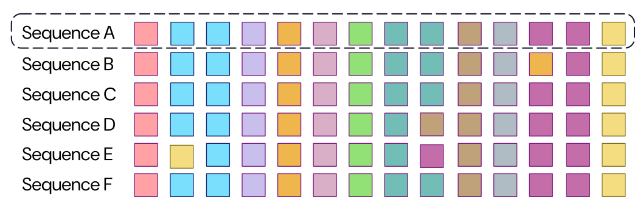
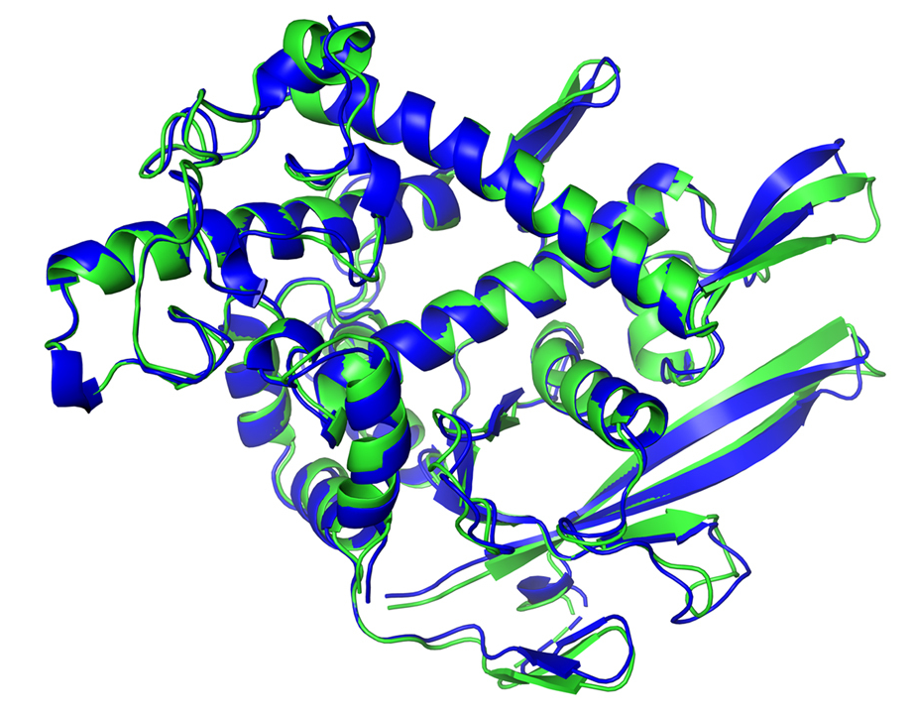
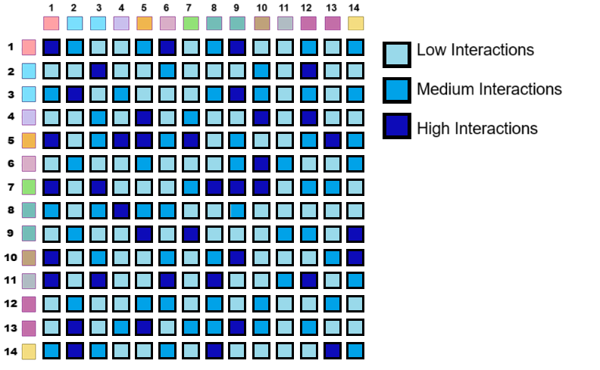
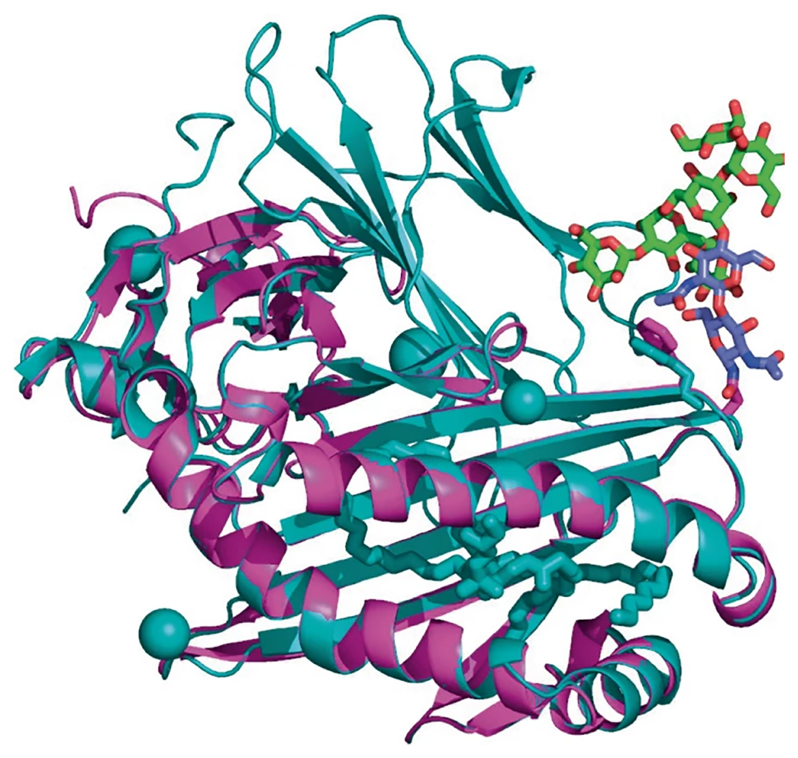
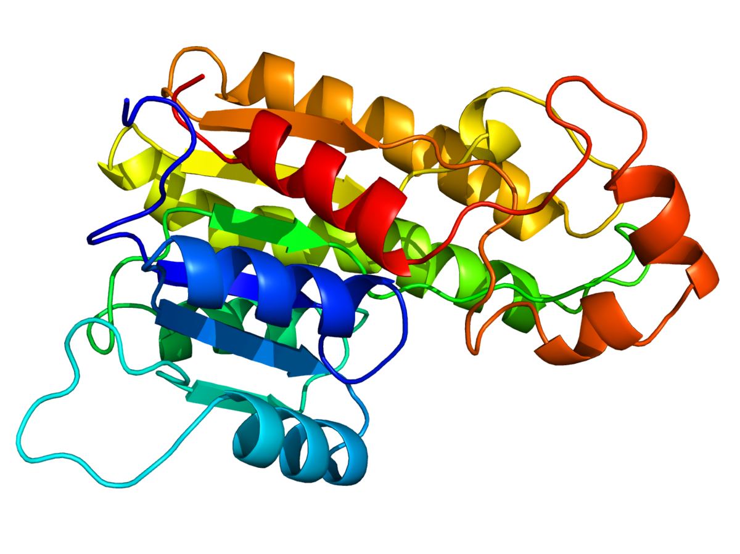
Pair representation allows AlphaFold to examine how every amino acid in a sequence interacts with each other
Which of these templates (or combination of them) gives the most helpful information for this residue pair?

Slide 10
AlphaFold3 begins by considering evolution, structure, and small molecule chemistry
Search for experimentally validated protein structures with similar amino acid sequences
Search for similar amino acid sequences to construct a multiple sequence alignment (MSA)
Generates initial 3D structures of small molecules (ligands, covalent bonds, etc.)
*Only needed for complex assemblages

Slide 11
AlphaFold3 uses generative modeling to predict beyond just single proteins
Search for Similar Examples
Prepare Data for Neural Network
Credit: Abramson et al. (2024)

Slide 12
The input embedder transforms biological features into atom-level representations that can be used by the neural network
Sequence features
Biological input data
Pair representation
Numerical representations (embeddings)
Features specific to each residue or molecule
Notes:
Translates biological input data — such as sequences, MSAs, and molecular structures — into numerical representations (embeddings) that the neural network can use.
Sequence features - Amino acid type, Relative position, Structural roles or ligand type (e.g., cofactor vs. ion)
Pair Representation - Evolutionary co-variation (from the MSA), Spatial proximity (from template structures), Cross-molecule context (protein–ligand, protein–RNA

Slide 13
AlphaFold3 uses generative modeling to predict beyond just single proteins
Search for Similar Examples
Prepare Data for Neural Network
Extract Evolutionary & Structural Constraints
Credit: Abramson et al. (2024)

Slide 14
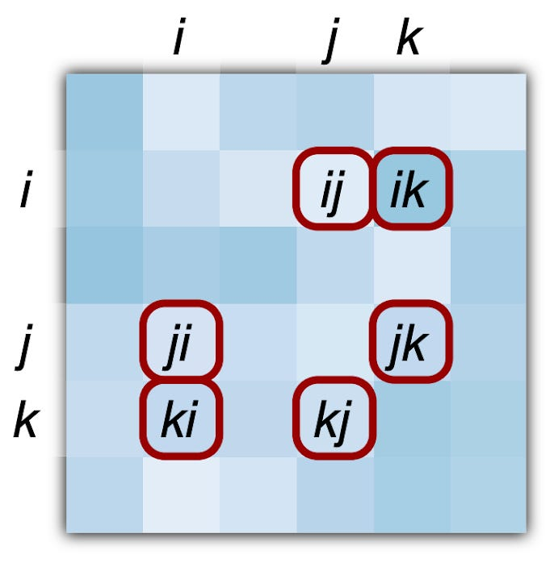
AlphaFold3 builds context from homologous sequences and structures
Conserved Regions
Co-Evolving Regions
Variable Regions
Which of these templates (or combination of them) gives the most helpful information for this residue pair?
Across all these related sequences, how do changes at one position relate to changes at another — and what does that tell us about their likely 3D relationship?
Notes:
The initial template search largely bypasses the input embedder and is instead passed directly into the Template Module. This module takes your input sequence and the known 3D structures of proteins with similar amino acid sequences (the templates), and extracts relevant structural features from them. It then uses attention to evaluate — for every residue pair — which template (or combination of templates) provides the most informative and reliable structural cues. This process is repeated twice before being passed onto the Pairformer. In doing so, the Template Module helps guide the model toward plausible spatial arrangements, especially when evolutionary data from the MSA is sparse or ambiguous.
While some information from the initial MSA is passed into the embedder, most of it is fed directly into the MSA Module, which has four main steps. First, the MSA is randomly subsampled to reduce computational load while preserving evolutionary diversity. The selected sequences are then embedded to allow for processing by the neural network. Next, it computes the average amino acid couplings across all residue pairs to determine co-evolutionary couplings. This co-evolutionary coupling is then passed to the pair representation, which provides the attention signals that guide how the MSA is updated. Then this process repeats 3 more times to refine the final MSA

Slide 15
AlphaFold3 uses generative modeling to predict beyond just single proteins
Search for Similar Examples
Prepare Data for Neural Network
Extract Evolutionary & Structural Constraints
Generate Structural Hypothesis
Credit: Abramson et al. (2024)

Slide 16
The Pairformer generates structural hypotheses by reasoning how each amino acid interacts with one another
1.) How is a influenced by others?
a
2.) How does a influence others?
b → a c → a
3.) Are there any tripartite relationships?
a → b → c
a ← b → c
a ↔ b ↔ c
a → b a → c
b
c
4.) Do these tripartite relationships make sense, given other tripartite relationships?

Slide 17
AlphaFold3 uses generative modeling to predict beyond just single proteins
Search for Similar Examples
Prepare Data for Neural Network
Extract Evolutionary & Structural Constraints
Generate Structural Hypothesis
Predicts Raw Atom Coordinates
Credit: Abramson et al. (2024)

Slide 18
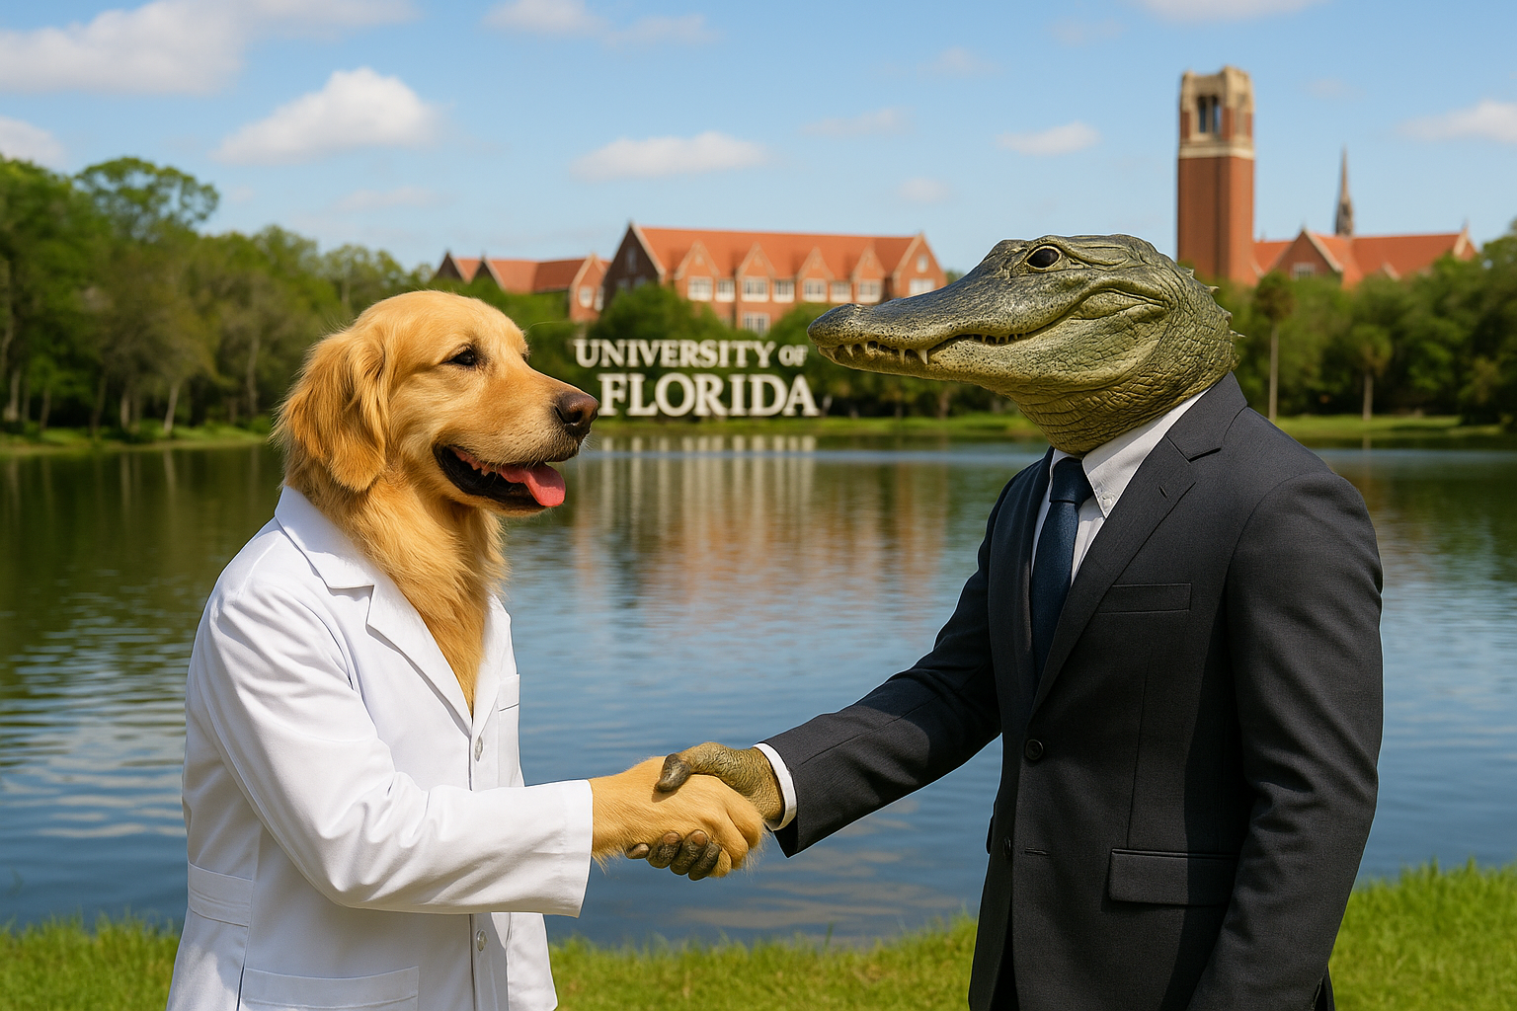
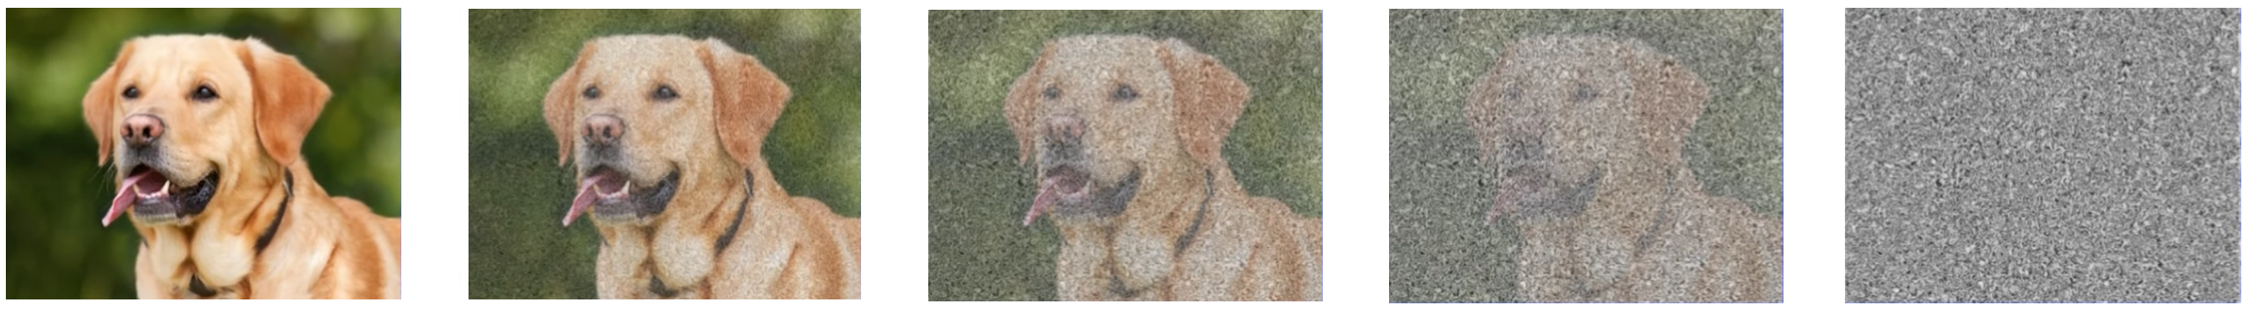
By learning how to undo noise on real data, diffusion models figure out the rules of the data’s structure — and use those rules to generate entirely new, realistic examples
Add Noise to Training Images
Learn to Remove Noise
Please generate an image of a golden retriever with a lab coat shaking hands with an alligator wearing a business suit that on the shore of a lake with the University of Florida's Century Tower in the background
Notes:
Diffusion models work by starting with a real image — like a photo of a Labrador retriever — and gradually adding random noise until the image is pure static. Then, they learn to reverse this process, step-by-step, until the original image is recovered. By practicing this on millions of images of millions of different things — like dogs, alligators, lakes, even the University of Florida — the model learns how different patterns and structures look. That way, when you give it a random cloud of noise and a prompt like “a golden retriever in a lab coat shaking hands with an alligator at UF,” it can sculpt that noise into a brand new image that fits the idea — even if that exact image has never existed before.

Slide 19
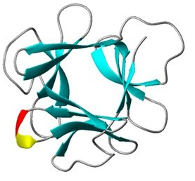
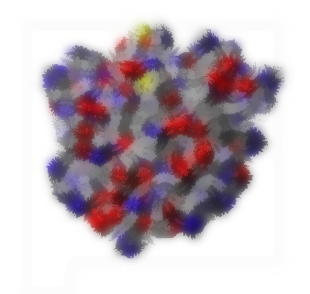
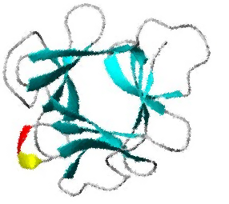
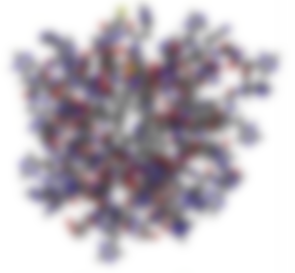
AlphaFold3 refines protein structure by gradually denoising a 3D atomic cloud into biologically accurate models
Output
Initialization (3x)
Refinement (24x)
Polishing (3x)
Creates rough draft based on Pairformer
Refine structure based on training
Polish to reduce remaining noise

Slide 20
AlphaFold3 uses generative modeling to predict beyond just single proteins
Search for Similar Examples
Prepare Data for Neural Network
Extract Evolutionary & Structural Constraints
Generate Structural Hypothesis
Predicts Raw Atom Coordinates
Generate Confidence Scores
Credit: Abramson et al. (2024)

Slide 21
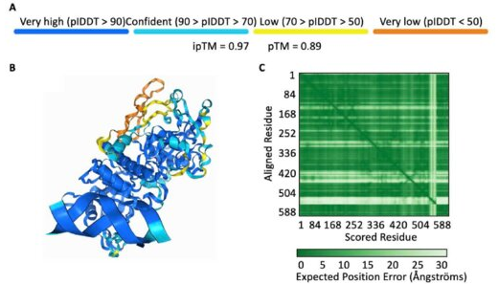
Confidence scores help you interpret which regions of the structure to trust — and which to treat with caution
pLDDT (Predicted Local Distance Difference Test) - Measures how confident AlphaFold is about the shape of a section of the protein
Higher is Better
pTM (Predicted Template Modeling Score) – Measures how confident AlphaFold is in the overall 3D structure of a single protein
Higher is Better
PAE (Predicted Aligned Error) – Measures how confident AlphaFold is about the relative position between two sections of the protein
Lower is Better
ipTM (Inter-Chain Predicted Template Modeling Score) - Measures how confident AlphaFold is about how multiple proteins fit together
Higher is better

Slide 22
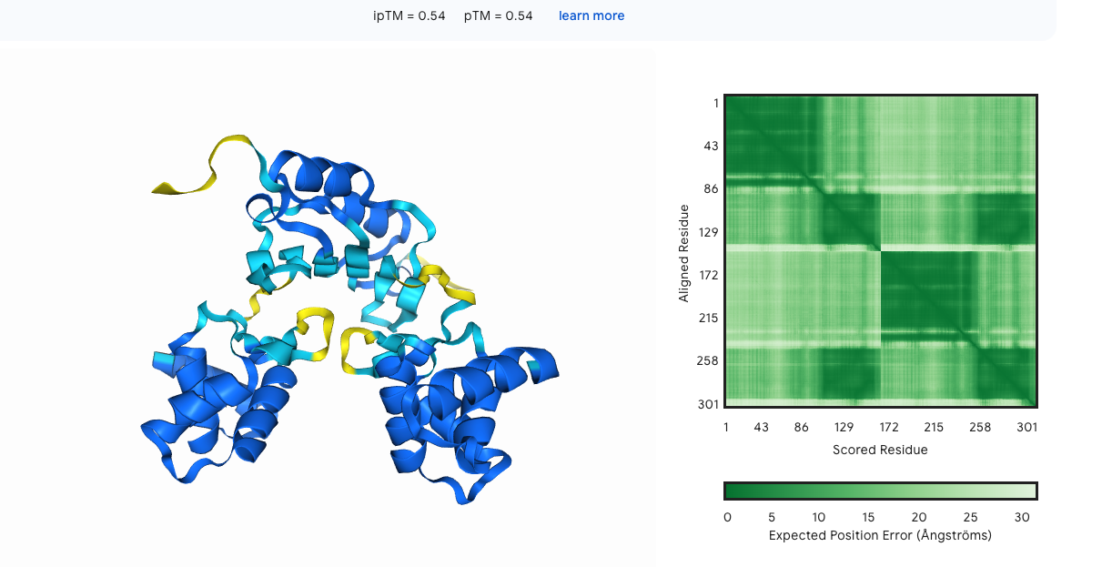
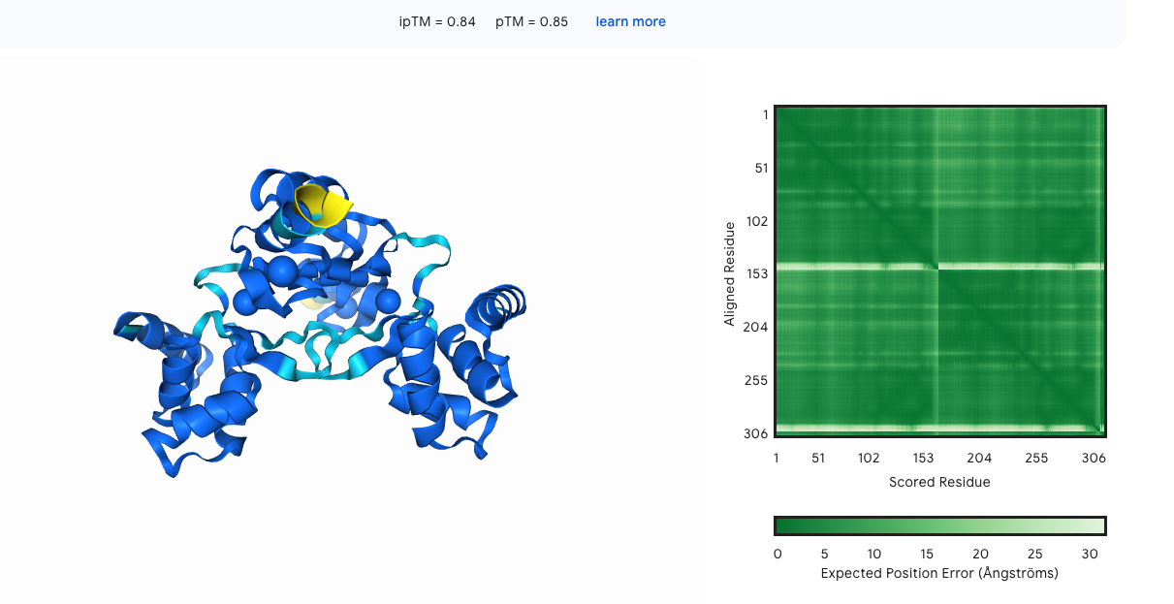
AlphaFold3 looks for full context when modeling
Confidence metrics of AlphaFold 3 (pLDDT, PAE, pTM, ipTM) may depend on having the full structural context.
No Zn or Fe
With Zn & Fe
Notes:
For instance, if you model metal-binding protein without metal ions, it could be modelled with lower confidence, indicating that important parts of the structure are missing. Adding metal ions will result in the confident prediction as all parts of the structure are in place.

Slide 23
AlphaFold3 uses generative modeling to predict beyond just single proteins
Search for Similar Examples
Prepare Data for Neural Network
Extract Evolutionary & Structural Constraints
Generate Structural Hypothesis
Predicts Raw Atom Coordinates
Generate Confidence Scores
Credit: Abramson et al. (2024)

Slide 24
AlphaFold3 represents a huge leap forward in protein modeling
Model | Accuracy | Key Limitations | Can Model | Cannot Model
AlphaFold v1 | ~60% backbone accuracy | Lower accuracy due to limits in side-chain placement Only models single proteins | Proteins | Everything else
AlphaFold v2 | Near-experimental accuracy( ~90%) on most proteins | Lower accuracy on more novel proteins due to heavy reliance on MSA Only models single proteins | Proteins | Everything else
AlphaFold v3 | Higher accuracy on proteins Can accurately model complexes (protein-protein, DNA, RNA, molecules, etc.) | Because AF3 is built with a diffusion model, it can hallucinate (but this is almost always reflected with low pLDDT scores) | Proteins DNA & RNA Ligands Ions Post-Translational Modifications Protein Complexes | Different protein conformations Complex binding strength, likelihood or thermodynamics
Notes:
AlphaFold3 can predict protein interactions — meaning it can show where and how different molecules (proteins, DNA, RNA, ligands, ions, etc.) are likely to fit together in 3D space.🚫 But it does not predict:Binding strength (how tightly they bind)Binding likelihood (whether they actually bind in real life)Thermodynamics or kinetics (e.g., binding free energy, K<sub>d</sub>, on/off rates)

Slide 25
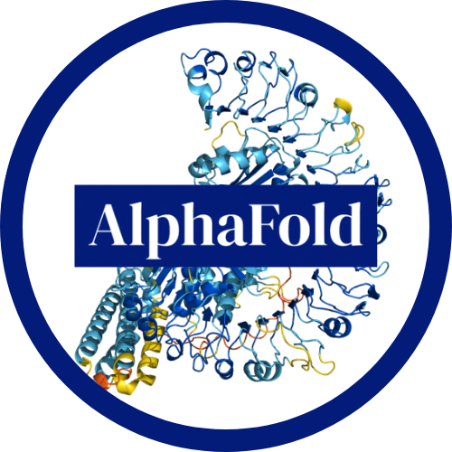
AlphaFold has greatly impacted and sped-up scientific progress in many sub-fields
Medicine
Increasing COVID vaccine efficacy²
Uncovering new proteins that can contribute to Alzheimer’s³
Environment
Discovery and design of plastic degrading enzymes⁴
Finding potential proteins for herbicide remediation⁵
Advancing Biology
Insights into statistical trends of protein evolution⁸
Uncovering divergence & evolution of plant pathogen proteins⁹
Plant Breeding
Designing of plant defense genes for boarder resistance⁶
Furthering understanding of salinity resilience in rice⁷

Slide 26

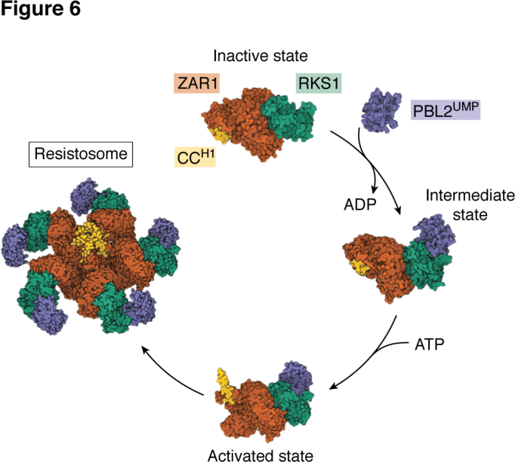
The developers of AlphaFold hope to improve the model’s accuracy and ability to model protein dynamics
References & Resources
Enhanced multi-molecular accuracy (ligands, PTMs, nucleic acids)
Modeling conformational dynamics and cellular context
Native support for mutational impact & protein design workflows
Credit: Benthem et al. (2024)

